Slide 1

Visual Question-Answering
Team Members:
Abdalla Shaaban Elsayed
Rabah Jamal Mohammed Ali
Abdullah Abdelkader Roshdy
Abdullah Mahmoud Abdullah
Supervisor:
Dr\ Sally Saad
Dr\ Ahmed Salah
1

Slide 2
Outline
Introduction
Problem definition
Objectives
System architecture
Working Phases
Results
Problems faced
Conclusion and Future Work
Demo
References
2

Slide 3
Outline
Introduction
3

Slide 4
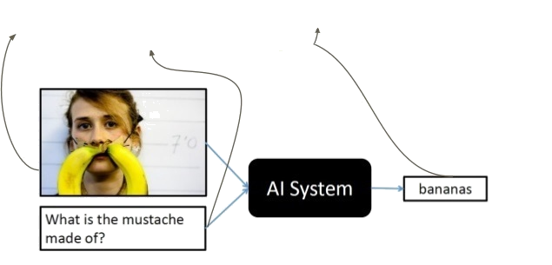
Introduction​
Question-Answering
Visual
Predict the Answer of a given question related to an image.
4

Slide 5
Outline
Introduction
Problem definition
5

Slide 6
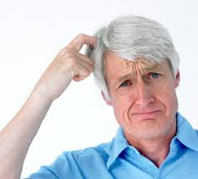
Problem definition
How to build a model that extract feature of an image related
to a given question ?
6

Slide 7
Outline
Introduction
Problem definition
Objectives
7

Slide 8
Objective
Our Graduation project aims to predict an answer for a given question about given image using co-attention technique.
The system is able to answer different types of questions includes objects, numbers, colors and locations.
8

Slide 9
Outline
Introduction
Problem definition
Objectives
System architecture
9

Slide 10
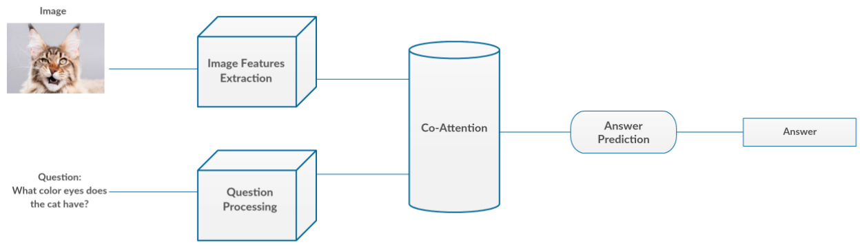
System architecture
10

Slide 11
Outline
Introduction
Problem definition
Objectives
System architecture
Working Phases
11

Slide 12
Phases Diagram
Data Preprocessing
Model Building
Model Interface
12

Slide 13
Phases Diagram
Data Preprocessing
13

Slide 14
Phases overview | Data preprocessing
Gathering Datasets
VQA Dataset
6,141,630 question-answers pairs.
COCO-QA Dataset
78,736 questions.
123,287 images.
Answer types including yes/no, number, and other.
184,612 images.
4 types of questions: object(70%), number(7%) , color(17%) , location(6%)
14
Notes:
COCO-QA:
Automatically generated from image captions.
123287 images
78736 train questions
38948 test questions
4 types of questions: object, number, color, location
Answers are all one-word.
91 category for train images
VQA:
248,349 training questions
121,512 validation questions
244,302 testing questions
101,434 test images

Slide 15
Phases overview | Data preprocessing
Preparing Dataset
Text
Cleaning the dataset using NLTK.
Apply one hot-encoding for a given question.
Images
Image resizing
15

Slide 16
Phases Diagram
Data Preprocessing
Model Building
16

Slide 17
Phases overview | Model Building
Question
Word Embedding
Question Hierarchy
Co-Attention
Encoding for Predicting Answers
Image
CNN
Image Feature
17

Slide 18
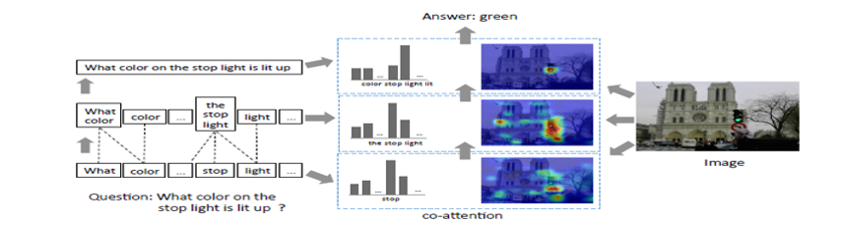
Phases overview | Model Building
Model over view
18

Slide 19
Phases overview | Model Building
Model over view
Words Level
18

Slide 20
Phases overview | Model Building
Model over view
Words Level
Phrases Level
18

Slide 21
Phases overview | Model Building
Model over view
Words Level
Phrases Level
Question Level
18

Slide 22
Phases overview | Model Building
Question
Image
19

Slide 23
Phases overview | Model Building
Question
Image
CNN
Image Feature
20

Slide 24
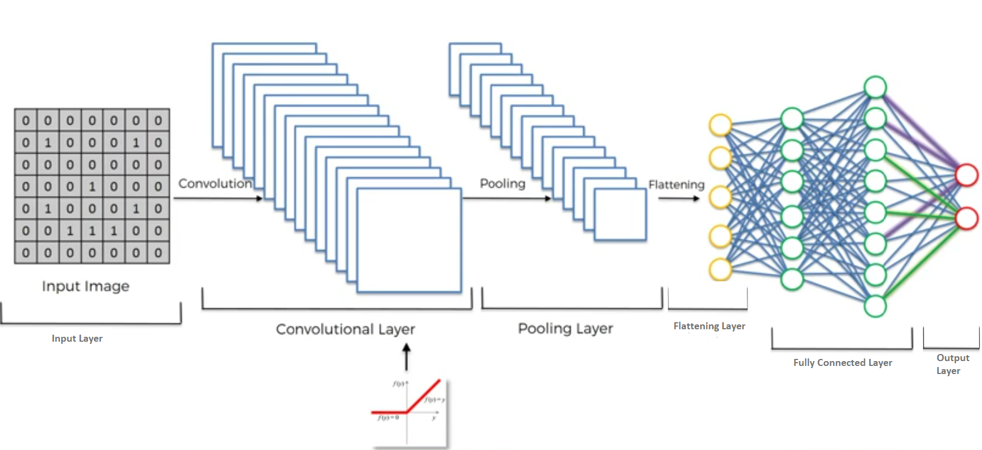
Phases overview | Model Building
Features Extraction of the image.
CNN Hierarchy
21

Slide 25
Phases overview | Model Building
Features Extraction of the image.
CNN Hierarchy
Input layer
21

Slide 26
Phases overview | Model Building
Features Extraction of the image.
CNN Hierarchy
Convolution
layer
21

Slide 27
Phases overview | Model Building
Features Extraction of the image.
CNN Hierarchy
Non-Linear Function (RELU)
21

Slide 28
Phases overview | Model Building
Features Extraction of the image.
CNN Hierarchy
Pooling layer
21

Slide 29
Phases overview | Model Building
Features Extraction of the image.
CNN Hierarchy
Flattening
layer
21

Slide 30
Phases overview | Model Building
Features Extraction of the image.
CNN Hierarchy
Fully connected
layer
21

Slide 31
Phases overview | Model Building
Features Extraction of the image.
CNN Hierarchy
Output
layer
21

Slide 32
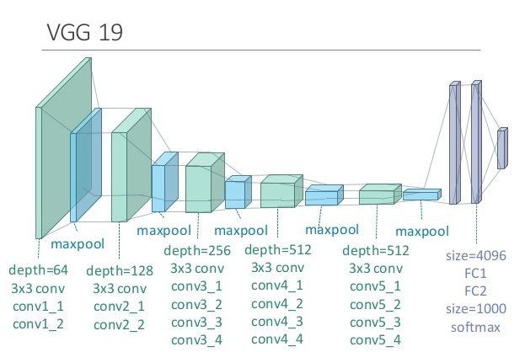
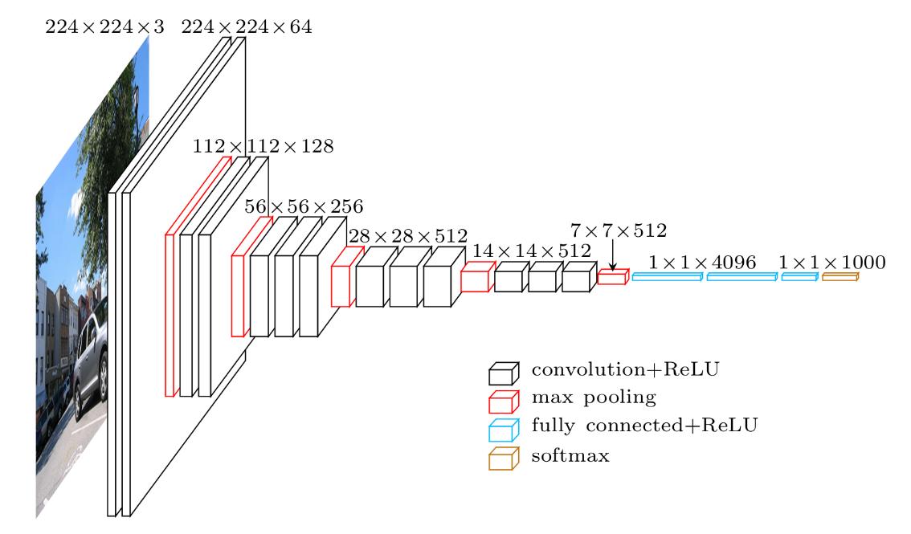
Phases overview | Model Building
Features Extraction of the image.
VGG
VGG 16
22

Slide 33
Phases overview | Model Building
Features Extraction of the image.
Our VGG
23

Slide 34
Phases overview | Model Building
Features Extraction of the image.
rescale the image.
24

Slide 35
Phases overview | Model Building
Features Extraction of the image.
rescale the image.
We input the image to VGG.
24

Slide 36
Phases overview | Model Building
Features Extraction of the image.
rescale the image.
We input the image to VGG19.
We take the activation from the last pooling layer of VGG as its feature
24

Slide 37
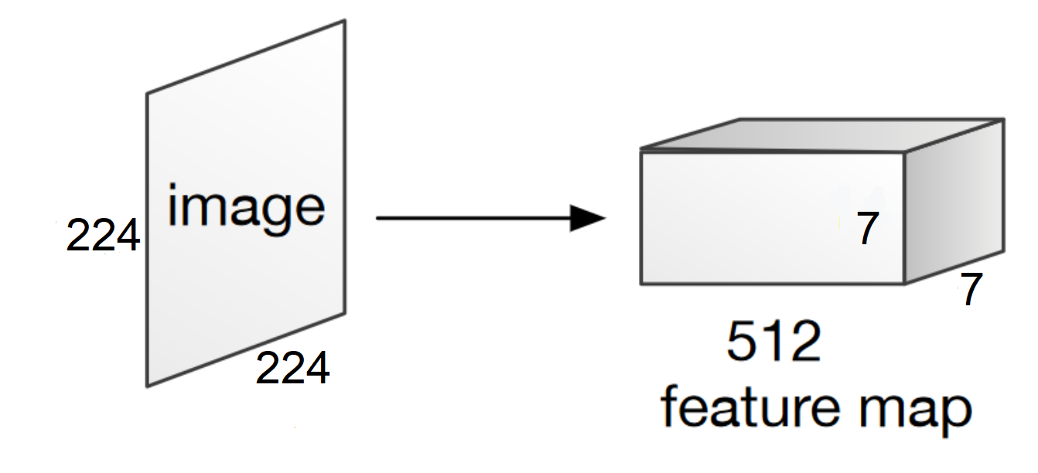
Phases overview | Model Building
Features Extraction of the image.
25

Slide 38
Phases overview | Model Building
Question
Word Embedding
Question Hierarchy
Image
CNN
Image Feature
26

Slide 39
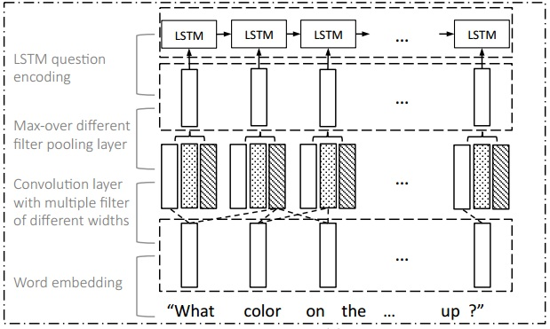
Phases overview | Model Building
Question Hierarchy
27

Slide 40
Phases overview | Model Building
Question Hierarchy
Word Level
27

Slide 41
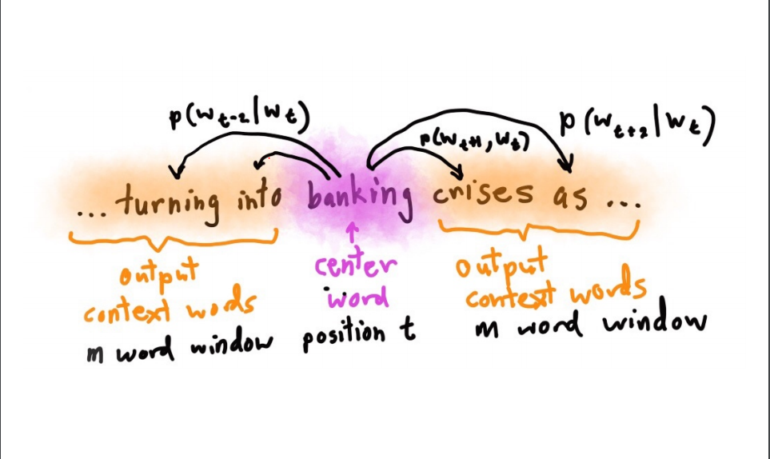
Phases overview | Model Building
Question Hierarchy
Word Level
Word embedding : A technique to embed the words to vector space , so that the words which have similar or close meaning have close vectors .
Word embedding Models
28

Slide 42
Phases overview | Model Building
Question Hierarchy
Word Level
Phrase Level
29

Slide 43
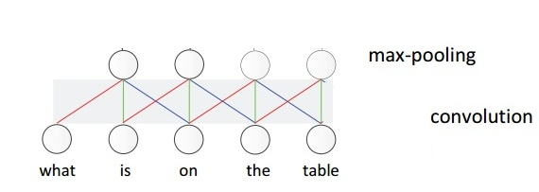
Phases overview | Model Building
Question Hierarchy
Phrase Level
The meaningful composition “ on the table” is more likely to be pooled out, compared with the composition “on the”.
30

Slide 44
Phases overview | Model Building
Question Hierarchy
Phrase Level
The meaningful composition “on the table” is more likely to be pooled out, compared with the composition “on the ”.
30

Slide 45
Phases overview | Model Building
Question Hierarchy
Phrase Level
The meaningful composition “on the table” is more likely to be pooled out, compared with the composition “on the”.
30

Slide 46
Phases overview | Model Building
Question Hierarchy
Phrase Level
The meaningful composition “on the table” is more likely to be pooled out, compared with the composition “on the ”.
30

Slide 47
Phases overview | Model Building
Question Hierarchy
Phrase Level
To compute the phrase features , we apply 1-D convolution on the word embedding vectors
The convolution and max-pooling processes exploit and summarize the local relation signals between consecutive words.
max-pooling layer :
is utilized to extract most informative features from among convolutions
31

Slide 48
Phases overview | Model Building
Question Hierarchy
Word Level
Phrase Level
Question Level
32

Slide 49
Phases overview | Model Building
Question Hierarchy
Question Level
We use a LSTM to encode the sequence of phrase level after max-pooling. The corresponding question-level feature is the LSTM hidden vector at time t.
33

Slide 50
Phases overview | Model Building
Question
Word Embedding
Question Hierarchy
Co-Attention
Image
CNN
Image Feature
34

Slide 51
Phases overview | Model Building
Attention
Visual attention : Based on text, which spatial location at image should we look at
Question attention : Based on image, which part of the question should we look at
Co-attention : applying both of them
35

Slide 52
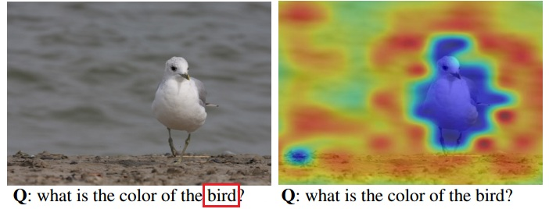
Phases overview | Model Building
Attention
Question Attention Visual attention
36

Slide 53
Phases overview | Model Building
Co - Attention
Parallel Co-Attention : Parallel co-attention attends to the image and question simultaneously, we connect the image and question by calculating the similarity between image and question features at all pairs of image-locations and question-locations
37

Slide 54
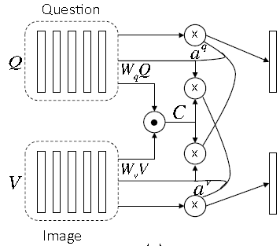
Phases overview | Model Building
Co - Attention
38

Slide 55
Phases overview | Model Building
Co - Attention
Calculating the affinity matrix
38

Slide 56
Phases overview | Model Building
Co - Attention
Calculating the attention probabilities of each image region and question word
38

Slide 57
Phases overview | Model Building
Co - Attention
Calculating the image and question attention vectors
38

Slide 58
Phases overview | Model Building
Question
Word Embedding
Question Hierarchy
Co-Attention
Encoding for Predicting Answers
Image
CNN
Image Feature
39

Slide 59
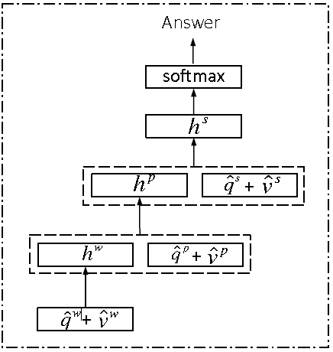
Phases overview | Model Building
Encoding for Predicting Answers
40

Slide 60
Phases overview | Model Building
Encoding for Predicting Answers
At word level obtain phrase level and enter the co-attention model to obtain attended image and question related to word
40

Slide 61
Phases overview | Model Building
Encoding for Predicting Answers
At phrase level obtain question level and enter the co-attention model to obtain attended image and question realted to phrase
40

Slide 62
Phases overview | Model Building
Encoding for Predicting Answers
At question level just enter the co-attention model to obtain attended image and question related to question
40

Slide 63
Phases overview | Model Building
Encoding for Predicting Answers
Soft max probability distribution for vocabulary
40

Slide 64
Phases Diagram
Data Preprocessing
Model Building
Model Interface
41

Slide 65
Phases overview | Interface
We built a user interface for the system, which allows the user to interact with the system.
We used Python’s framework with CSS and Javascript for web interface, Java and xml for android interface
42

Slide 66
Outline
Introduction
Problem definition
Objectives
System architecture
Working Phases
Results
43

Slide 67
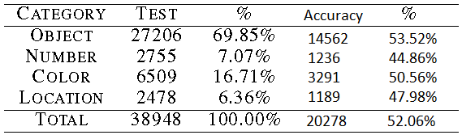
Results
We achieved 52.06% accuracy on the testing dataset that covers 20,278 samples of the total 38,948 testing samples.
We enhanced our model to achieve better accuracy but we would not able to retrain the model because of the resources unavailability.
44

Slide 68
Outline
Introduction
Problem definition
Objectives
System architecture
Working Phases
Results
Problems faced
45

Slide 69
Problems faced
Dealing with large image datasets.
Finding recourses for training our model.
Lack of researches that cover this problem.
46

Slide 70
Outline
Introduction
Problem definition
Objectives
System architecture
Working Phases
Results
Problems faced
Conclusion and Future Work
47

Slide 71
Conclusion and Future Work
Conclusion
In our system, we tried to make an effective application to answer an image related to a given question by merging between natural language processing and convolution neural network. We got an overall accuracy 52.06% accuracy on the testing dataset that covers 20,278 sample of the total 38,948 testing samples.
The system is able to answer different types of questions includes objects, numbers, colors and locations.
48

Slide 72
Conclusion and Future Work
Future Work
Deal with more different types of questions.
Generate complete answers using encoder decoder model.
Increase the classifier training data.
Visualizing the attention between the Image and the question.
Publishing the application on Google store and Apple store.
49

Slide 73
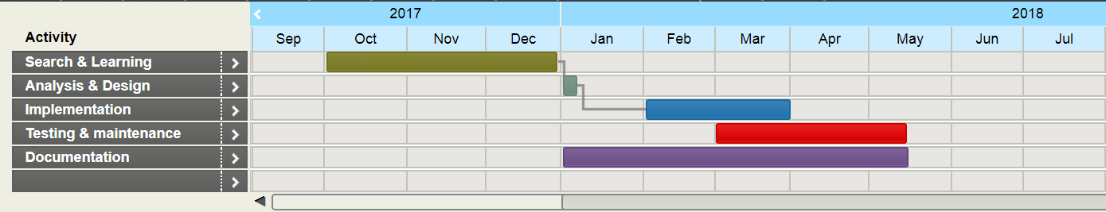
Time Plan

Slide 74
Outline
Introduction
Problem definition
Objectives
System architecture
Working Phases
Results
Problems faced
Conclusion and Future Work
Demo
50

Slide 75
Demo
51

Slide 76
Outline
Introduction
Problem definition
Objectives
System architecture
Working Phases
Results
Problems faced
Conclusion and Future Work
Demo
References
52

Slide 77
References
Chenyue Meng and Yixin Wang, “Image-Question-Linguistic Co-Attention for Visual Question Answering”, 2016.
Alisha Rege and Payal Bajaj C, “From Vision to NLP: A Merge”, 2017.
Ronghang Hu and Jacob Andreas and Marcus Rohrbach, “Learning to Reason: End-to-End Module Networks for Visual Question Answering” , 2017.
Jiasen Luand Jianwei Yang and Dhruv Batra , “Hierarchical Question-Image Co-Attention for Visual Question Answering” , 2017
Stanislaw Antol, Aishwarya Agrawal, Jiasen Lu, Margaret Mitchell, Dhruv Batra, C Lawrence Zitnick,and Devi Parikh. Vqa: Visual question answering. In ICCV, 2015.
Mengye Ren, Ryan Kiros, and Richard Zemel. Exploring models and data for image question answering.In NIPS, 2015.
Tsung-Yi Lin, Michael Maire, Serge Belongie, James Hays, Pietro Perona, Deva Ramanan, Piotr Dollár,and C Lawrence Zitnick. Microsoft coco: Common objects in context. In ECCV, 2014.
Karen Simonyan and Andrew Zisserman. Very deep convolutional networks for large-scale image recognition.CoRR, abs/1409.1556, 2014.
Kaiming He, Xiangyu Zhang, Shaoqing Ren, and Jian Sun. Deep residual learning for image recognition.In CVPR, 2016
53

Slide 78
Questions
54

Slide 79
Thank You!
55

